Slide 1
Packages
Lecture 26

Slide 2
Learning objective
After the completion of today’s session you will be able to:
Illustrate the use of packages.
Import packages and use it in your code.
Select appropriate predefined packages in your code.

Slide 3
Packages – introduction:
Packages are containers for classes. A java package is a group of similar types of classes, interfaces and sub-packages.
They are used to keep the class name space compartmentalized. For example, a package allows you to create a class named List, which you can store in your own package without concern that it will collide with some other class named List stored elsewhere.
Packages are stored in a hierarchical manner and are explicitly imported into new class definitions.
Package in java can be categorized in two form, built-in package and user-defined package.
There are many built-in packages such as java, lang, awt, javax, swing, net, io, util, sql etc.
Our main discussion will be on user defined package.

Slide 4
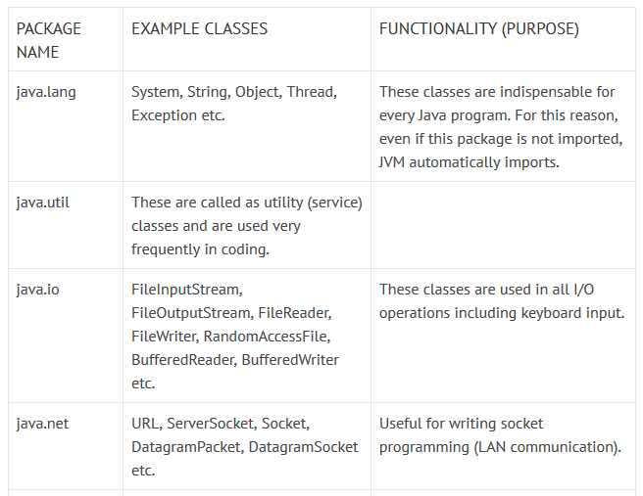
Predefined Java Packages

Slide 5
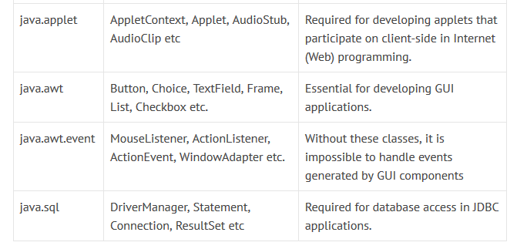
Predefined Java Packages

Slide 6
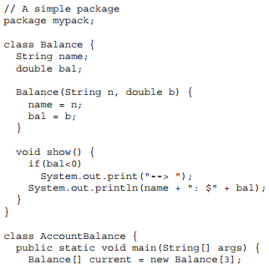
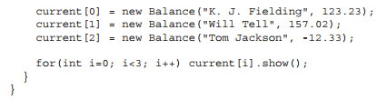
Example

Slide 7
Compiling and Running the packages
First save the .java file in the respective working directory.
For compiling use the following command:
javac -d directory javafilename
The -d switch specifies the destination where to put the generated class file.
Eg.
C:\Users\kumar-pc\Desktop\JavaCodes>javac -d C:\Users\kumar-pc\Desktop\JavaCodes AccountBalance.java
Or
C:\Users\kumar-pc\Desktop\JavaCodes>javac -d . AccountBalance.java
Dot(.) represents the current folder
The above will create a package named mypack in the folder JavaCodes
For running use the following command:
java mypack.Classfilename
Eg.
C:\Users\kumar-pc\Desktop\JavaCodes>java MyPack.AccountBalance

Slide 8
Importing Packages
All of the standard core java classes are stored in some named package.
Since classes within packages must be fully qualified with their package name or names, it could become tedious to type in the long dot-separated package path name for every class you want to use.
For this reason, Java includes the import statement to bring certain classes, or entire packages, into visibility.

Slide 9
Running imported packages
First create the package
Then before compiling the file which is importing the package set the class path.
C:\Users\kumar-pc\Desktop\JavaCodes>set classpath=C:\Users\kumar-pc\Desktop\JavaCodes\P1;.;

Slide 10
Thanks

